Slide 1
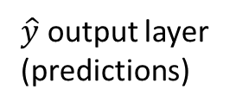
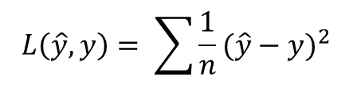

Node
$$L\left(\hat{y},y\right)= \sum{{\frac{1}{n}(\hat{y}−y)}^{2}}$$
Node
Node
Node
Label
Node
$\hat{y}$ output layer
(predictions)
$y$ (actual)
X input layer
Hidden layer
Notes:
p1

Slide 2



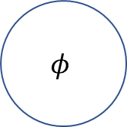




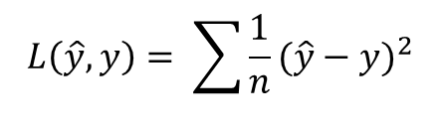




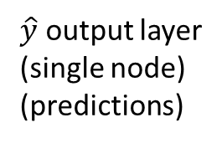


$$L\left(\hat{y},y\right)= \sum{{\frac{1}{n}(\hat{y}−y)}^{2}}$$
$$h= f(w^{T}x_{i}+b^{T})$$
$$b_{1}$$
f
$$w_{1}$$
$$\hat{y}=φ(ωf(w^{T}x_{i}+b^{T})+β)$$
$$ω_{1}$$
$$β_{1}$$
x
$$b_{2}$$
f
$$φ$$
$$w_{2}$$
$$ω_{2}$$
Label
$$w_{3}$$
$$ω_{3}$$
f
$\hat{y}$ output layer
(single node)
(predictions)
$$b_{3}$$
$y$ (actual)
X input layer
(single node)
Hidden layer
(3 nodes)
Notes:
p.1.1 detailed

Slide 3

Notes:
p2

Slide 4
y
h
Delay
Recurrent Layer
x input
Notes:
p3

Slide 5
y
y(t-1)
y(t)
y(t+1)
h
h(t-1)
h(t)
h(t+1)
Unfold
Delay
x input
x(t-1)
x(t)
x(t+1)
Notes:
p4

Slide 6


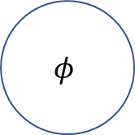






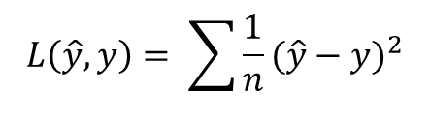





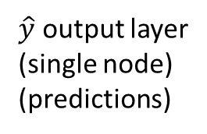


h(t—1)
$$u_{1}$$
h(t—1)
$$u_{2}$$
h(t—1)
$$u_{3}$$
$$h_{i}\left(t\right)=h= f(w^{T}x_{i}+diag(h_{i}(t−1))u^{T}+b^{T})$$
$$L\left(\hat{y},y\right)= \sum{{\frac{1}{n}(\hat{y}−y)}^{2}}$$
f
$$b_{1}$$
$$β_{1}$$
$\hat{y}=φ(ωf(w^{T}x_{i}+diag(h_{i}(t−1))u^{T}+b^{T})+β$)
$$w_{1}$$
$$b_{2}$$
$$ω_{1}$$
x
f
$$φ$$
Label
$$w_{2}$$
$$ω_{2}$$
$$w_{3}$$
$$ω_{3}$$
f
$$b_{3}$$
$\hat{y}$ output layer
(single node)
(predictions)
$y$ (actual)
X input layer
(single node)
Hidden layer
(3 nodes)
Notes:
P5 RNN

